Slide 1
Nonprofit Security Grant Program
-Awardee Orientation-

Slide 2

Congratulations on your award!
You have been selected by the Department of Homeland Security (DHS) for funding.
The performance period for the FY24 NSGP NSS Award is May 1, 2025, and ends April 30, 2028.
Your Agreement date begins May 1, 2025, and ends December 31, 2027, which will allow the SAA time for close-out activities.
Award Agreements were sent out on September 19, 2025. If you did not receive your award announcement from KHP please let us know.
The Award Agreements contain standard language required Federally to include mutual agreement, fiscal agent agreements, required articles and special conditions
Please read thoroughly through this agreement and ensure all highlighted items are completed.
Notes:
Remember to review your project workbook before beginning any work to ensure what you have agreed on is not in conflict with your statements of faith, etc.

Slide 3
Congratulations on your award - What’s next?
Now that you have received notification - there are a few steps to complete before spending can begin.
First - you should have received notification and your original Investment Justification (Application) you submitted with some forms needed for signature which include;
  W9 - which is the first step on our end to set up accounts for tracking and reimbursement
  Sexual Harassment form - State of Kansas requirement before funds will be released
  Israeli Boycott form - State of Kansas requirement
  Covered Technology form – State of Kansas requirement
  If your award amount is different than the original application amount, you will need to revise and return the updated Investment Justification (Application) to reflect the awarded allocation. The SAA is required to submit an amendment back to FEMA to remove any holds placed on the awardees.
  All these forms and updates must be signed and returned to KHP before any activities can begin.
Notes:
W-9 must have legal name with the IRS listed

Slide 4
What’s next? - Continued
  Once you have signed and returned all forms and agreements;
  KHP Accounting will create a Reimbursement Form specific to your nonprofit which will be sent out with additional instructions.
  Don’t worry - we can walk you through it - we still have another step.
  If your project was identified as requiring an Environment Historic Preservation Assessment approval (EHP) there is one more step to complete before ANY physical work on your facility can begin.
  Do NOT begin any physical work on your facility until you have received an Official FEMA EHP approval which will be forwarded to you from the SAA.

Slide 5
Environmental Historic Preservation assessment (EHP)
Recipients and Subrecipients are required to obtain an EHP review by submitting a screening form to determine whether the proposed project has the potential to affect the environmental and/or historic properties. FEMA Policy #108-023-1
The form https://www.fema.gov/media-library/assets/documents/90195 can be completed and forwarded to NSGP.KHP@KS.GOV for submission.
EHP reference is also located at http://www.datacounts.net/nsgp .
Our team is here to help walk you through the EHP steps. Do not hesitate to reach out to us directly. We also provide webinars and one-on-one tutorials where possible.
Notes:
Show EHP tool in Datacounts

Slide 6

Now your set - Lets get to work!
Once you have a green light to begin work, lets start thinking ahead to approval, documentation and submitting reimbursement requests.
Review your project to ensure what you are about to do is preapproved
If there are any modifications needed, seek pre-approval from the SAA. In most modification cases, FEMA must be involved, and approval can take more time
Notes:
The Authorized Equipment List can be found on Datacounts

Slide 7
Procurement
When selecting a vendor, choosing Equipment, Training, Exercise or Planning activities; its imperative you follow the State of Kansas Procurement Policy and can justify the expense with back-up documentation when submitting a Reimbursement Request.
Considerations should also include but not limited to;
License, bonding, insurance, warranties, maintenance agreements and the ability to deliver within the performance period
Refer to your Award Agreement for any Special Conditions
The following checklists will help you make the right choices and think ahead to reimbursement submission.
Notes:
Bonding only applies to jobs $250,000.00 or greater, which does not apply to NSGP awards. However, if you are combining other funding sources that will equal or exceed that threshold

Slide 8
Procurement - Thresholds
State Contract Used – No further action for procurement is required
Expense at or less than $4,999.99
No competitive bidding. However, three (3) inquiries are best practice
Expense between $5,000 to $24,999.99
Minimum of three (3) quotes received
Expense is between $25,000 to $49,999.99
Sealed bid process used
Invitation to Bid
Public Bulletin Board (can be your nonprofits website) - 3 day minimum
Expense is at or greater than $50,000
Sealed bid process used
Invitation to Bid
Kansas Register https://sos.ks.gov/publications/kansas-register.html - 10 day minimum
Notes:
Examples can be found on Datacounts. If a State Contract is used the vendor must supply a copy.

Slide 9
Planning - Reimbursement Checklist
Planning Reimbursement Review
 | Grant Year: |  |  | Reimbursement Number:
 | Project Name: |  |  | Region/Agency:
 | Documentation Review
 |  |  |  | Reimbursement Amount:
 | Identified in Project Workbook |  |  |  | $
 | Travel Documentation |  |  | Voucher Number
 | Contractor |  |  | Voucher Date
 | Additonal Expenses |  |  | Vendor Check Date
 | Reviewer:
 | Date:
 | Additional Comments:

Slide 10
Organization / Salary - Reimbursement Checklist
Salaried Employee/Contracter Reimbursement Review
 | Grant Year: |  |  | Reimbursement Number:
 | Project Name: |  |  | Region/Agency:
 | Documentation Review |  | Indirect Cost Review
 |  |  |  | Reimbursement Amount:
 | Contract/Position Description on file |  | Indirect Cost Approval on file |  | $
 | Payoll information attached |  | Indirect cost fees calculated | Voucher Number
 | Bill for contracted services attached |  |  | Voucher Date
 | Reviewer: |  | Reviewer:
 | Date: |  | Date:
 | Additional Comments:

Slide 11
Equipment - Reimbursement Checklist
Equipment Reimbursement Review
 | Grant Year: |  |  | Reimbursement Number:
 | Project Name: |  |  | Region/Agency:
 | Documentation Review |  | Equipment Review
 | Item(s) are listed in the Project Workbook |  | Equipment is authorized in the AEL | Reimbursement Amount:
 |  |  | (https://www.fema.gov/authorized-equipment-list ) |  | $
 | Procurement Method
 | State Contract Used |  | AEL number has been entered | Voucher Number
 |  |  | on inventory
 | Expense at or less than $4,999.99 |  | Equipment has been added to inventory | Voucher Date
 | No competitive bidding
 |  |  | Contact information has been entered | Vendor Check Date
 | Expense between $5,000 to $24,999.99
 | Minimum of three (3) quotes received |  |  | SAM Verificaiton
 |  |  | $5,000 Tag
 | Expense is between $25,000 to $49,999.99 |  | No | TOPA
 | Sealed bid process used |  | Yes & Number:
 | Invitation to Bid
 | Public Bulletin Board - 3 day minimum |  | Tag letter mailed or delivered
 | Expense is at or greater than $50,000
 | Sealed bid process used
 | Invitation to Bid
 | Kansas Register - 10 day minimum
 | Reviewer: |  | Reviewer:
 | Date: |  | Date:
 | Additional Comments:
Notes:
End User Responsibilities addressed later

Slide 12
Training - Reimbursement Checklist
Training Reimbursement Review and Checklist
 | Grant Year: |  |  | Reimbursement Number:
 | Project Name: |  |  | Region/Agency:
 | Expense Review |  | Documentation Review
 | Item(s) are listed in the Project Workbook |  | SAA has pre-approved course | Reimbursement Amount:
 |  |  |  |  | $
 | Expense Type(s) |  | Course Description / Agenda Provided
 | Trainer / Contractor |  |  | Voucher Number
 |  |  | Participant List Provided
 | Attendee Reimbursement |  |  | Voucher Date
 | (Milege, Per Diem, Lodging) |  | If meal provided - pre-approval received
 |  |  |  | Vendor Check Date
 | Lodging / Direct Bill (Group)
 | Food / Meal Reimbursment
 | Backfill/Overtime
 | Additional Training Expenses
 | Reviewer: |  | Reviewer:
 | Date: |  | Date:
 | Additional Comments:

Slide 13
Exercise - Reimbursement Checklist
Exercise Reimbursement Review
 | Grant Year: |  |  | Reimbursement Number:
 | Project Name: |  |  | Region/Agency:
 | Expense Review |  | Exercise Review
 | Item(s) are listed in the Project Workbook |  | Exercise has been pre-approved | Reimbursement Amount:
 |  |  |  |  | $
 | Expense Type(s) |  | Participant List has been provided
 | Contractor |  |  | Voucher Number
 |  |  | Exercise materials have been provided
 | Attendee Reimbursement |  |  | Voucher Date
 | (Milege, Per Diem, Lodging) |  | If food provided - pre-approval received
 |  |  |  | Vendor Check Date
 | Lodging / Direct Bill (Group) |  | If not received AAR / IP discussion with
 |  |  | Project Manager has occurred
 | Food / Meal Reimbursment
 | Backfill/Overtime
 | Additional Exercise Expenses
 | Reviewer: |  | Reviewer:
 | Date: |  | Date:

Slide 14
Reimbursement Request / Cover Sheet

Slide 15
Reimbursement Process
To encourage a consistent, fixed, and timely approach to processing reimbursement requests from sub-recipients, KHP HSO and Accounting staff will process reimbursement requests as soon as possible after receipt.
KHP Accounting intends to conduct a drawdown weekly with exception of holidays. If there is a holiday or other reason KHP Accounting cannot complete a drawdown they may alter the drawdown date or hold until the next week. Reimbursement requests submitted by Tuesday mornings should make the drawdown Wednesday.
While KHP HSO will try to ensure all reimbursements received during the week will be in the drawdown, those received later in the week may be delayed until the next drawdown.
Sub-recipients should submit reimbursement requests as they incur. However, at a minimum, reimbursement requests will be submitted on at least a monthly basis to ensure better processing of requests.
Reimbursement requests are usually submitted electronically and readable with signatures being present.
Reference: 2 CFR 200.305 Payment

Slide 16
Submittal of Reimbursement Request
Electronic reimbursement requests will be sent to the grant manager(s) attention. Lt. Edna Murphy at NSGP.KHP@KS.GOV and carbon copy KHP Homeland KHP.Homeland@KS.GOV .
The reimbursement request cover sheet must be accompanied by the following:
Completed Kansas Homeland Security Grant Program Reimbursement Request / Request for Funds coversheet with attached itemized invoice(s)
Supporting Source documentation related to reimbursement requests based on activity (Equipment, Exercises, Planning, Salary or Training)
Source documentation requirements for the appropriate reimbursement should include:
  Time and attendance records Payroll registers
  Fringe benefit rate Receipts
  Invoices and purchase orders Quote(s) or bid process documentation
  Executed contracts Travel authorization forms / travel vouchers
  Training / Exercise attendance records Course materials
  Meal sign-in sheets Cancelled checks / Financial institution statements

Slide 17
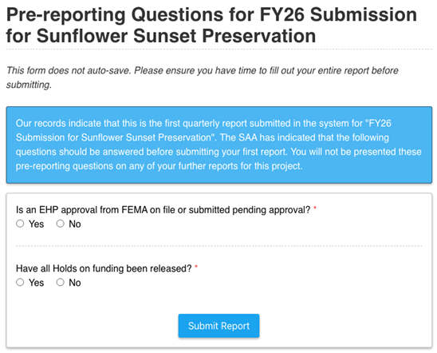
Quarterly Reporting – Example
Notes:
Quarterly reports are required until the project is complete

Slide 18
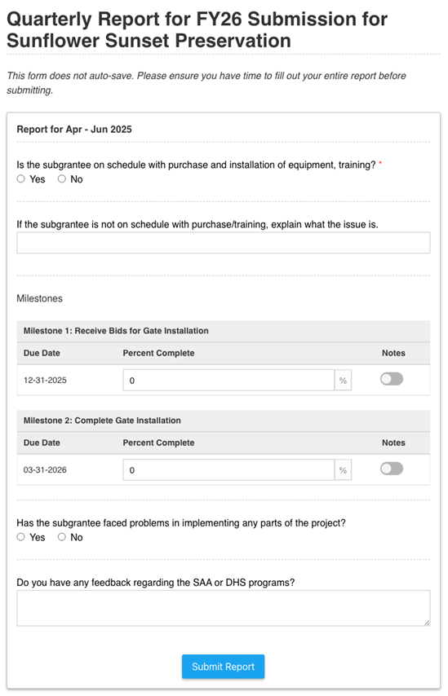
Quarterly Reporting – Example Continued
Notes:
Quarterly reports are required until the project is complete

Slide 19
End User Responsibilities
An inventory is required to be maintained by the End User for the life of equipment and reconciled annually. The SAA will work with the End User to reconcile annual inventory no later than September 30th. Next Annual Inventory due September 30, 2025.
The SAA is required to conduct two on-sight visits to monitor equipment requirements.
Equipment is to be maintained in good working order for the life of equipment.
Training should be included in the cost of training, and we encourage cross-training.
Planning, Training, Exercise and Equipment should consider ADA compliance.
Obtain pre-approval for any reasonable modifications to the project.

Slide 20
Resources
Nonprofit Security Grant Program resources website
http://datacounts.net/nsgp
FEMA-NSGP Guidance
https://www.fema.gov/grants/preparedness/nonprofit-security
Preparedness Grants Manual
https://www.fema.gov/grants/preparedness
Kansas Procurement
https://www.admin.ks.gov/offices/procurement-and-contracts
Code of Federal Regulations
https://www.ecfr.gov/cgi-bin/ECFR?page=browse
Kansas Homeland Security Preparedness Grant Programs Policy Manual
http://datcounts.net/nsgp

Slide 21

Contacts
Connie Satzler
EnVisage Consulting
6847 Anderson Ave. Manhattan, KS 66503
Phone: (785) 410-0410
csatzler@kansas.net
Lieutenant Edna Murphy K-299
Kansas Highway Patrol
Homeland Security / Emergency Operations
122 SW 7th Street Topeka, KS 66603-3847
785-296-2444 (Office)
785-207-0423 (Cell)
Edna.Murphy@ks.gov
Melissa McCoy
Kansas Highway Patrol
Homeland Security / Emergency Operations
122 SW 7th Street Topeka, KS 66603-3847
785-368-7187 (Office)
785-925-2148 (Cell)
Melissa.McCoy@ks.gov
NSGP.KHP@ks.gov

Slide 22
Questions?

